Slide 1
Analysis of Association Between Glucose and Incident Myocardial Infarction
Zach Frere, Zhenhui Xu, Hayley Nemeth

Slide 2
Objective
Study Aims:
To describe the distribution of glucose at Period 1 and incident MI at Period 2
To test the association between glucose at Period 1 and development of MI (incident MI) at Period 2

Slide 3
Hypothesis
Primary Hypothesis:
Higher glucose at Period 1 is associated with incidence of myocardial infarction at Period 2

Slide 4
Data Cleaning
Framingham Dataset - frmgham2.csv
Exclude Period 3 data
Exclude subjects with MI in Period 1
Create two datasets - Period 1 and Period 2
Merge datasets by RANDID
Include: Period 1 Glucose, Period 2 MI, Covariates
Remove NA’s
Outcome
Develop MI in Period 2
PERIOD = 2, PREVMI = 1 and PERIOD = 1, PREVMI = 0

Slide 5
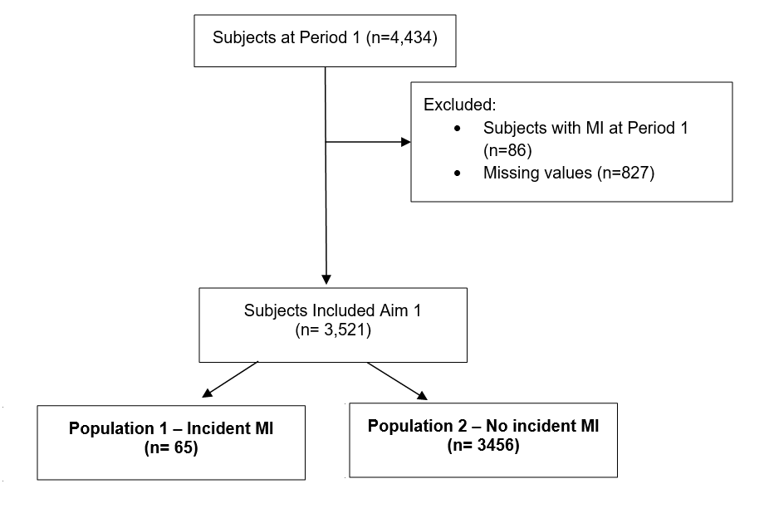
Consort Diagram

Slide 6
Table 1

Slide 7
Distribution

Slide 8
Analysis Results

